Slide 1
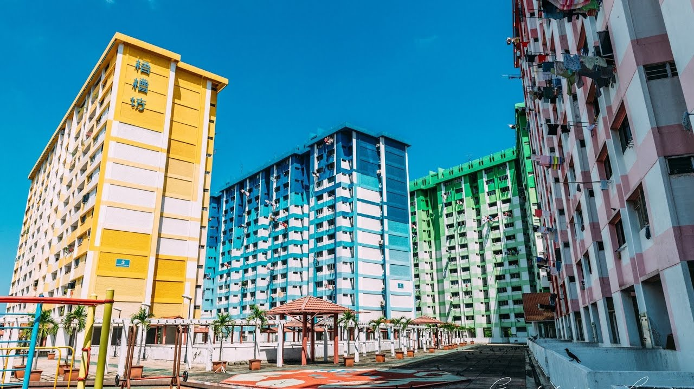
Singapore housing data set challenge
An analysis by Gabriel Kok

Slide 2
Introduction
Project Goal: to identify drivers of HDB resale price in Singapore
Background: Singapore has second most expensive housing markets in the world, despite 85% of Singaporeans living in government provided public HDBs.
The price of a HDB has huge variability. For example, median resale price of a 4 room is 330k in Woodlands, and 870k in Central (2018).
Well known drivers are: location, number of rooms, flat model

Slide 3
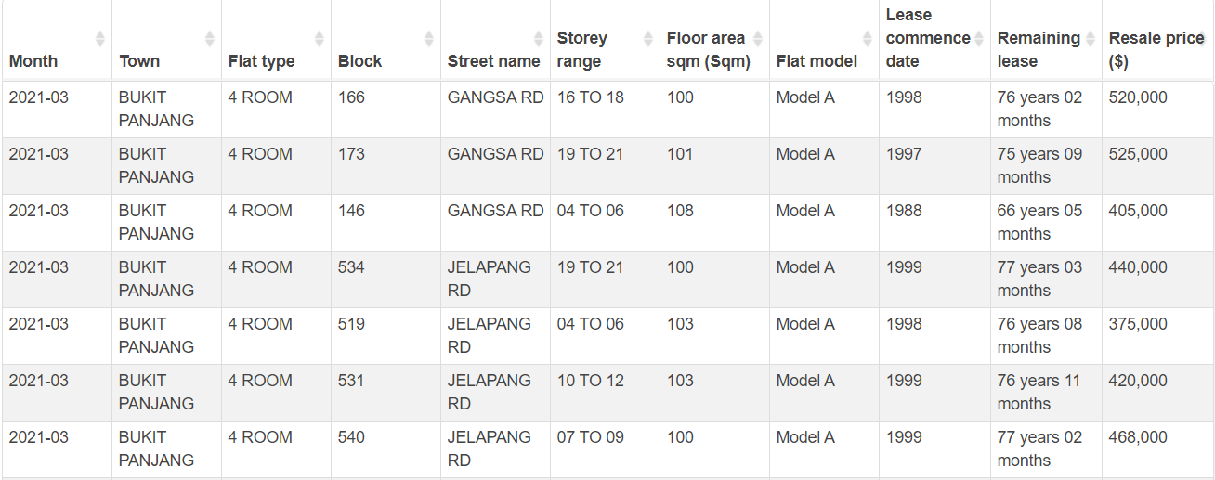
The Data
Obtained from data.gov.sg
From 1990 to 2021 Mar (present)
Over 840,000 rows

Slide 4
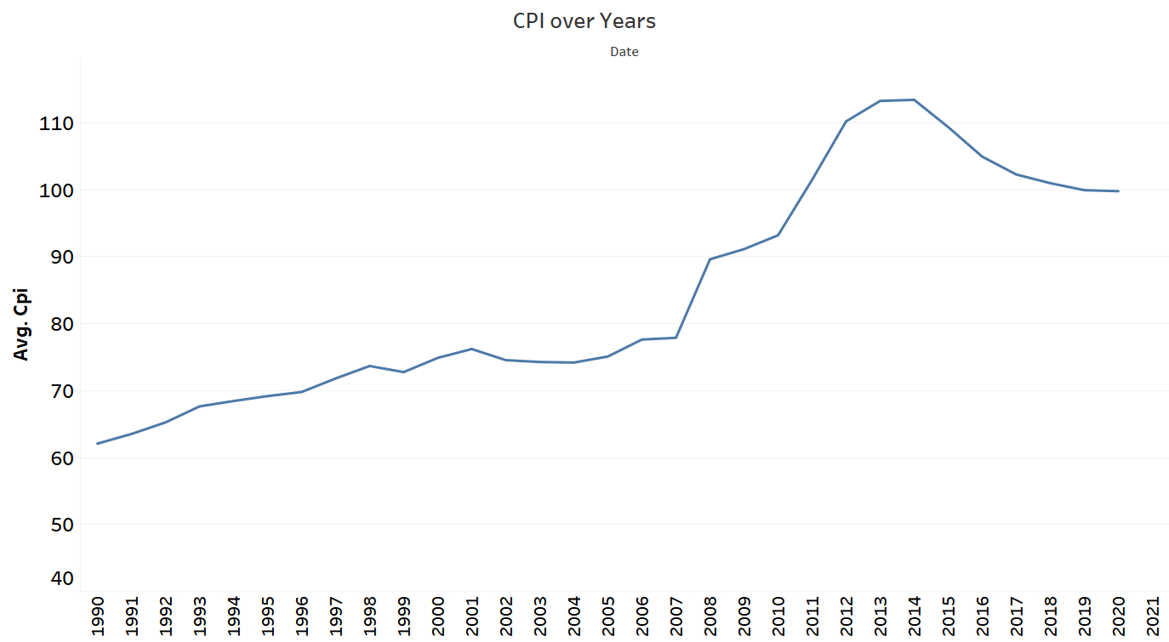
Data Cleaning
Transform Resale Price to Real Price based on CPI for housing and utilities
CPI data taken from https://www.singstat.gov.sg/find-data/search-by-theme/economy/prices-and-price-indices/latest-data
Allows us to compare resale price between each time period(month)
Formula: Real Price = Resale Price/CPI * 100

Slide 5
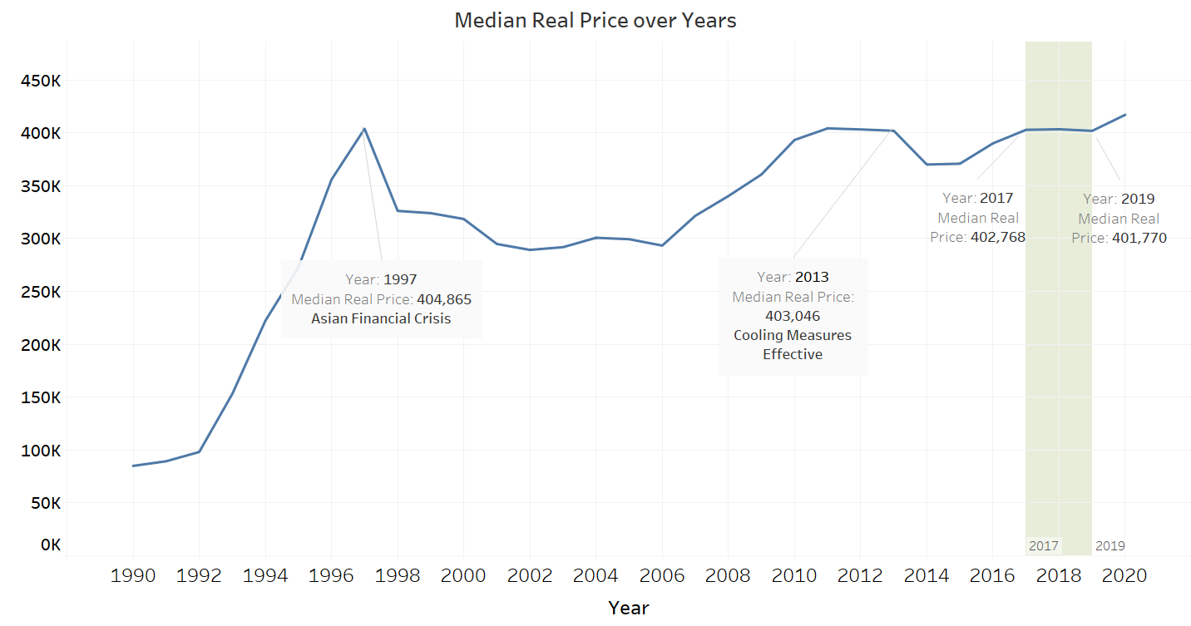
Exploratory Data analysis
Prices stable between 2017 and 2019
Median Real Price Over Time
Notes:
We plot the Median Real Price over time for the entire time period. We observe that price has been fluctuating for most of this time period.
The sharp descent from 1997 coincides with the Asian Financial Crisis, causing house prices to fall. Since 2006, it starts to gradually rise till 2013 where it drops again, due to MAS implementing cooling measures.
Between 2017 and 2019, prices are relatively stable. The amount of variation is only about $1000. In order to better understand the effect of other factors of housing price, we shall study price only in this time period. Also, this time period is most recent, so it reflects the current reality.

Slide 6
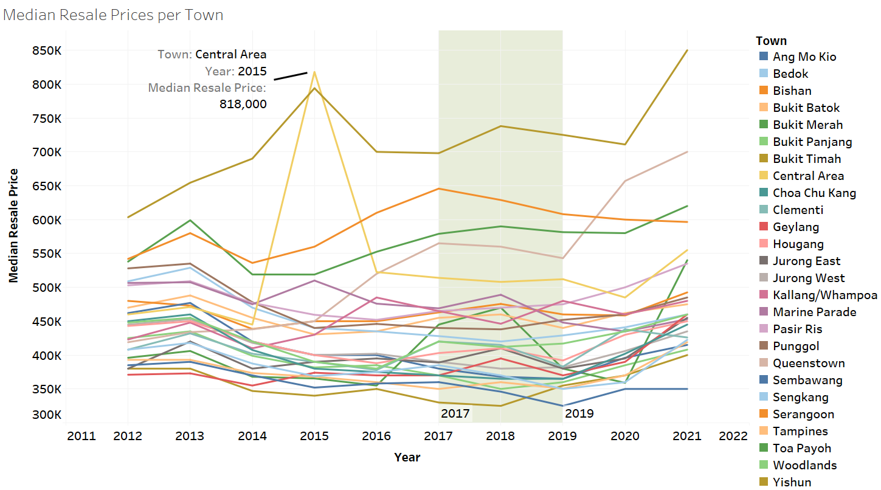
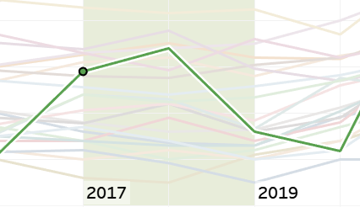
Exploratory Data analysis
Median Real Price per Town
Toa Payoh
Notes:
Between 2017 and 2019, median prices within each town are relatively stable as well, with the exception of Toa Payoh. (dropped from 470k in 2018 to 380k in 2019)

Slide 7
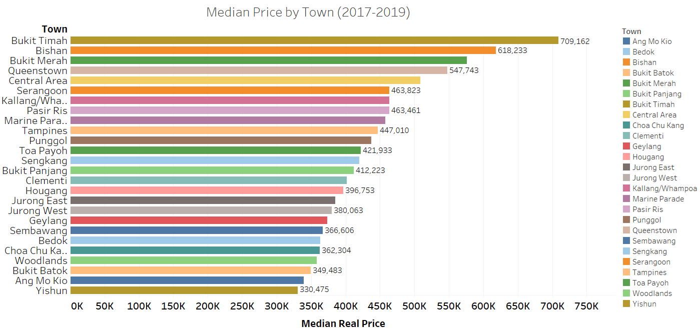
Exploratory Data analysis
Median Real Price per Town
Notes:
We plot Median Real Price per Town. We can see there is quite high variability between towns, ranging from 330k in Yishun to 709k in Bukit Timah

Slide 8
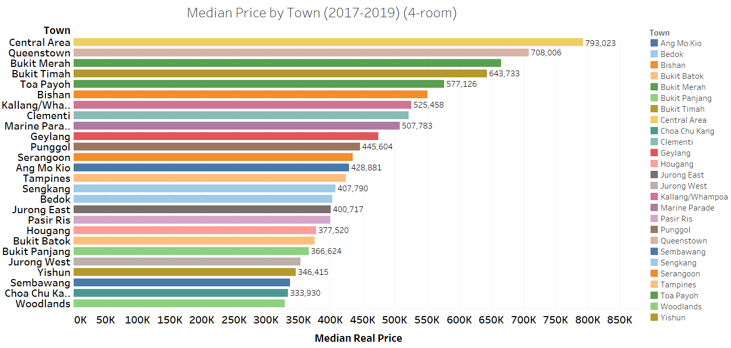
Exploratory Data analysis
Median Real Price per Town (4 room Flat)
Notes:
If we look only at 4room flats, we can see the order changes slightly. with Central Area the highest at almost 800k.
Since there are many towns we will group them into larger regions later, such as North, Central, East, ect.

Slide 9
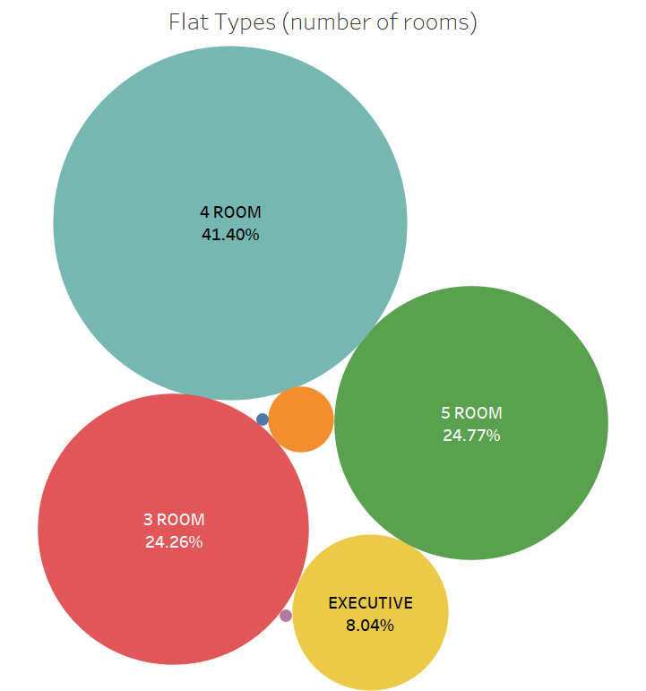
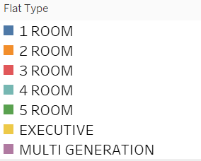
Exploratory Data analysis
Flat Types:
1 Room – 0.05%
2 Room – 1.43%
3 Room – 24.6%
4 Room – 41.4%
Executive – 8%
MultiGeneration - 0.05%
Notes:
The Blue and Purple circles represent 1 room and Multi Gen Flats respectively. Since there are very few instances, we shall remove these two categories

Slide 10
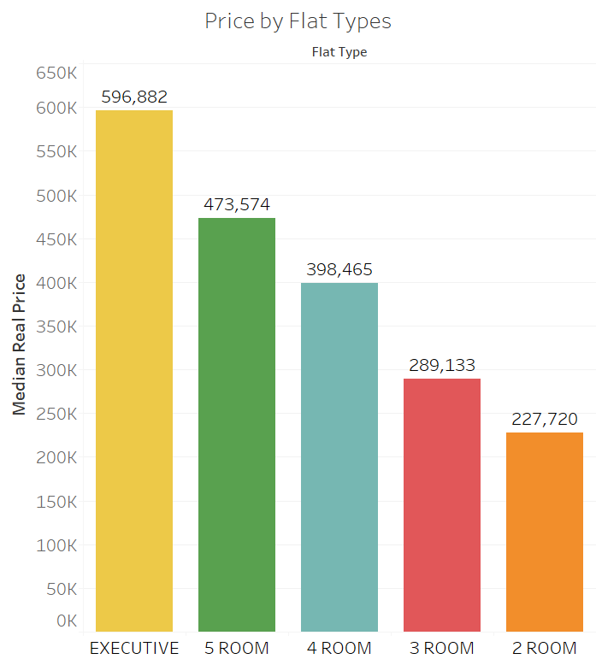
Exploratory Data analysis
Price by Flat Types
Median Price increases steadily as
Number of room increases
Executive type HDB is the most
Expensive flat type

Slide 11
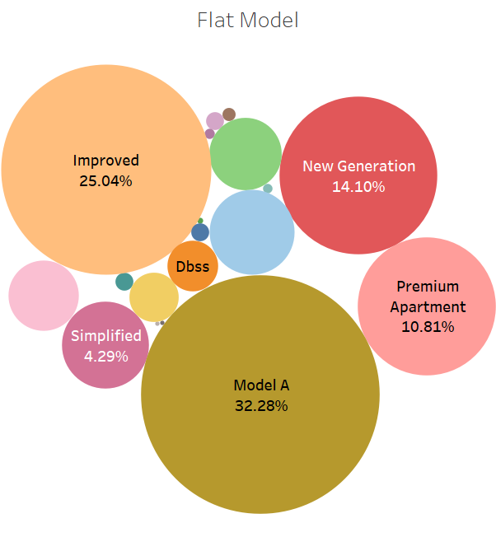
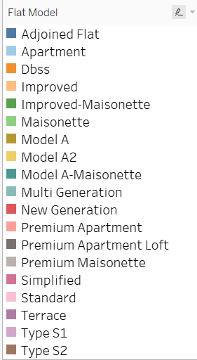
Exploratory Data analysis
Flat Model
Notes:
At first glance, There are 18 different types of Flat Model.
We should combine them into larger groups based on their similar characteristics

Slide 12
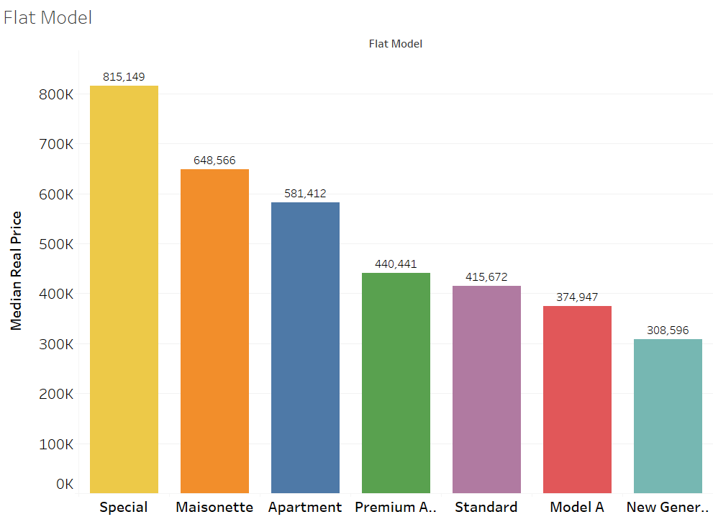
Exploratory Data analysis
Flat Model- Median Price
Model A Maisonette
Improved Maisonette
Premium Maisonette
Maisonette
Maisonette
Terrace
Adjoined Flat
Type S1
Type S2
DBSS
Special
Model A2
Model A
Simplified
Model A
Premium Apartment Loft
Apartment
Apartment
Notes:
We regroup the flat models into 7 new categories. They were grouped based on similar housing types.
Special –type contains Type S1S2, DBSS, all premium, limited design flats known for their high prices. Terrace and Adjoined Flats are naturally larger flats, so higher price too.

Slide 13
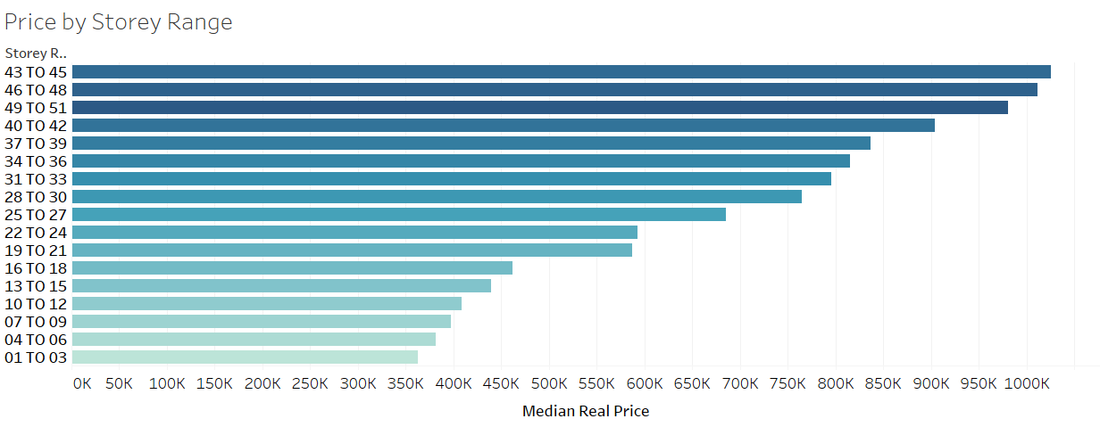
Exploratory Data analysis
Storey Range and Flat Price
Notes:
Generally, price increases the higher the storey range.

Slide 14
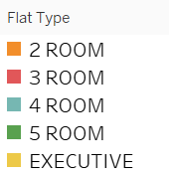
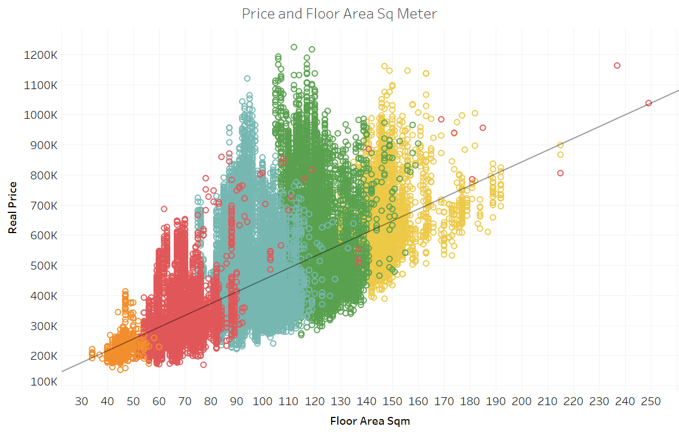
Exploratory Data analysis
Floor Square Area
Possible Outlier
Possible Outlier
Notes:
Plotting a scatterplot with floor area over Real price, we see there is a strong positive correlation between floor area and real price. This is expected in Singapore, as land area is scarce and thus the floor area highly contributes to overall house price.
The color indicates the number of rooms or flat type. Generally, we see that as number of room increases, the floor area will also increase. We can also see a few outliers that we should check out.

Slide 15
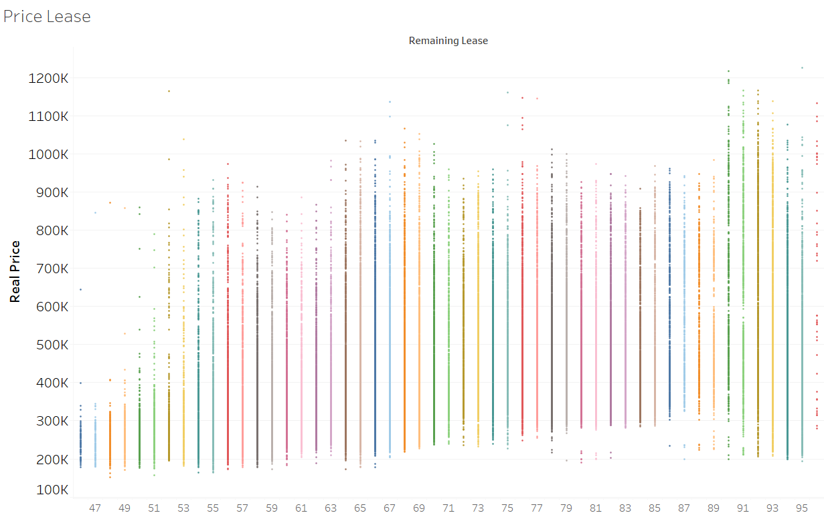
Exploratory Data analysis
Remaining Lease
Notes:
There does not seem to be a pattern with remaining lease years and real price. However, when remaining years drop below 50, the price potential drastically reduces

Slide 16

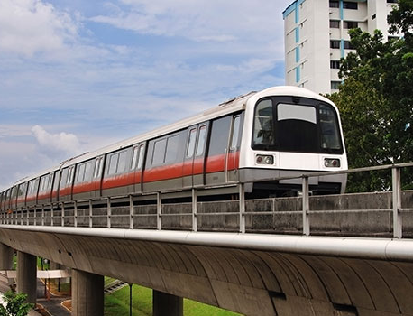
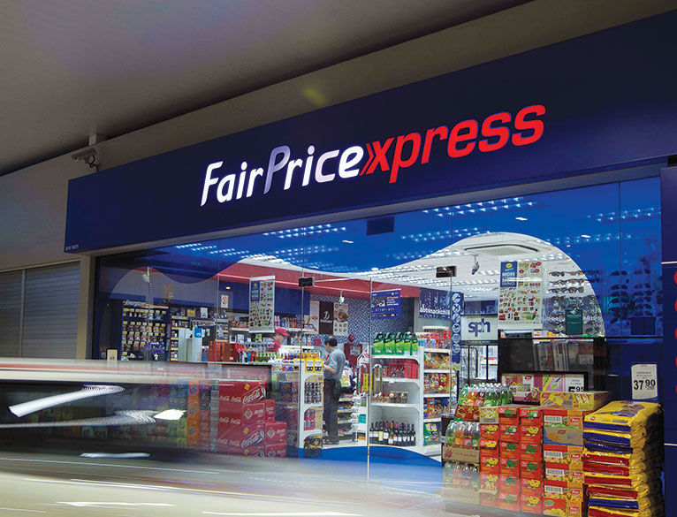
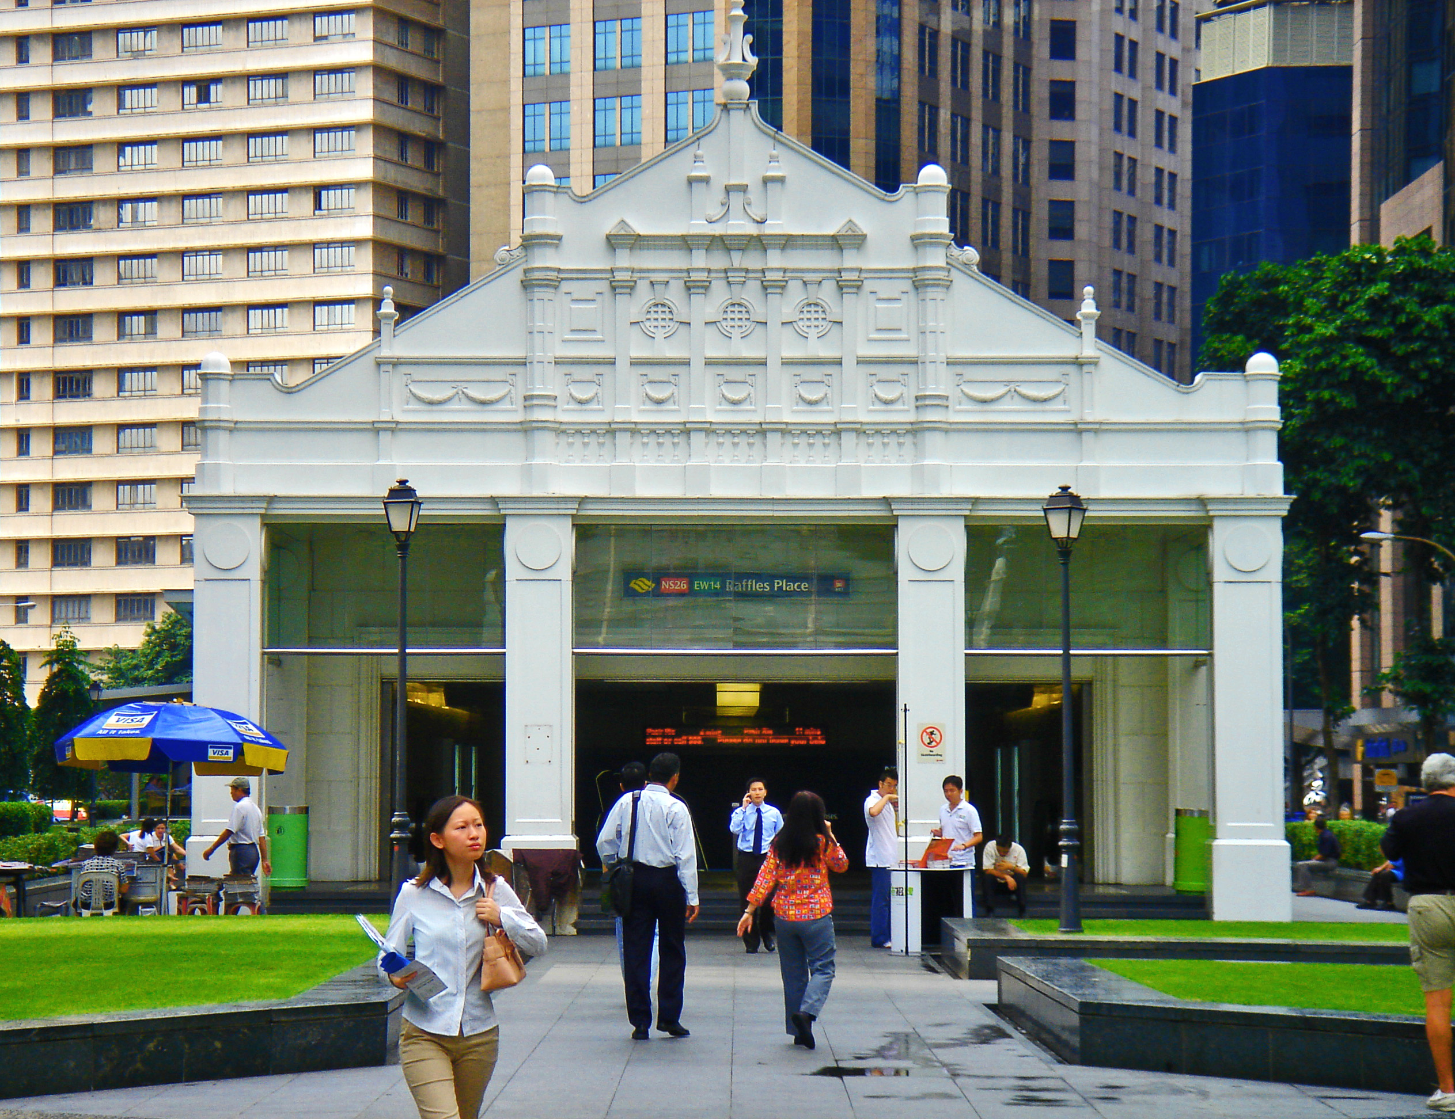
Feature Engineering
Based on our available information, we have the exact address for each house
We can retrieve the geographical coordinates for each address, and calculate the distance from each address to several amenities:
Distance to Nearest MRT
Distance to Nearest School
Distance to Nearest Supermarket
Distance to Nearest Hawker Center
Distance to Central (Raffles Place MRT)
Number of MRTs within 2km
Number of Schools within 2km
Number of Supermarkets within 2km
Number of Hawker Centers within 2km
The respective datasets were obtained from data.gov.sg. Onemap.sg api was used to retrieve the coordinates, which were then fed through other functions to obtain distance between 2 locations.

Slide 17
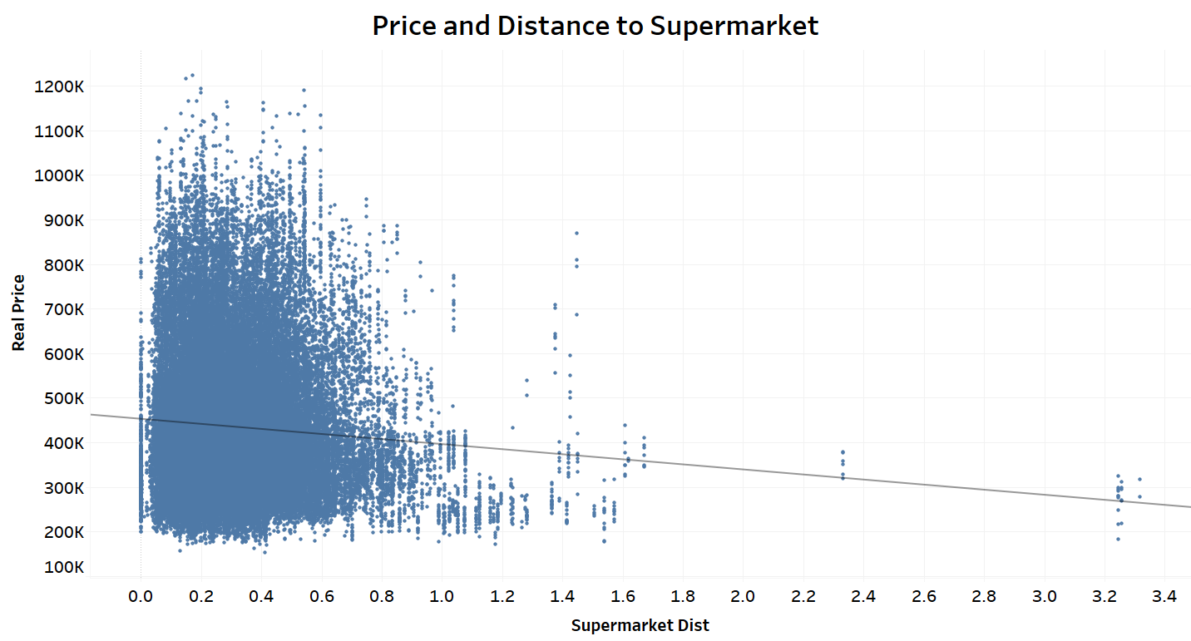
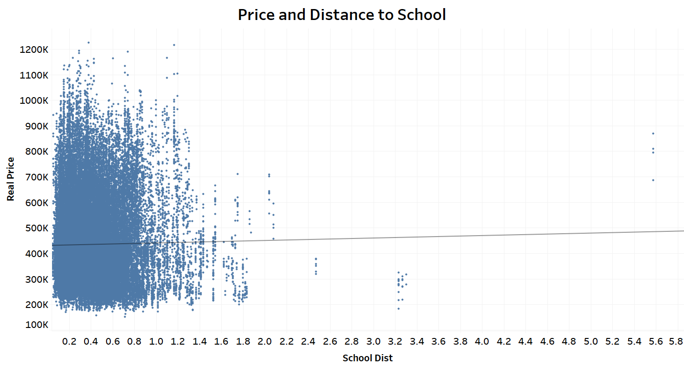
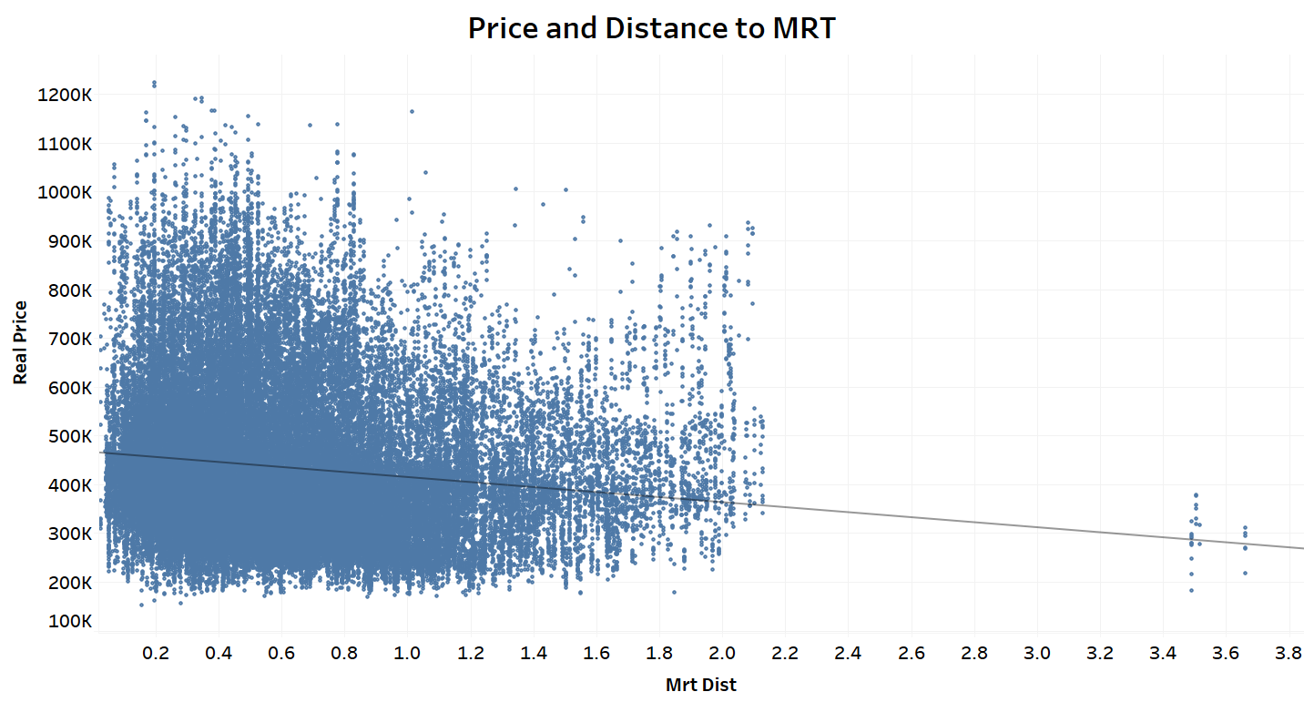
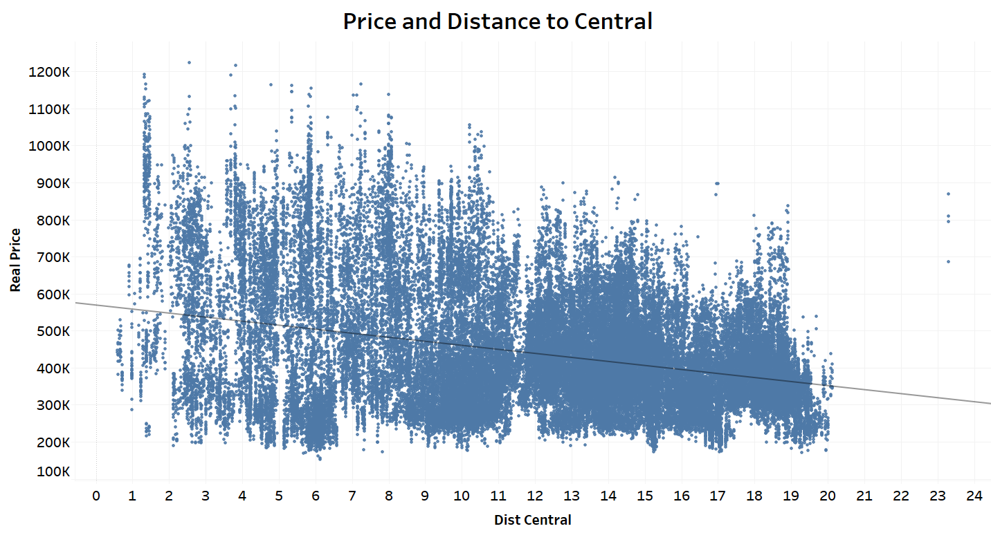
Feature Engineering
Distance and Price Trends for Nearest Supermarket, Nearest School, Nearest MRT and Central
Notes:
There seems to be a downwards trend for the Nearest Supermarket, MRT and Central, where the greater the distance, the lower the sale price. The trend seems to be stronger for Distance to Central.
However, the price does not seem very much affected by distance to nearest school.

Slide 18
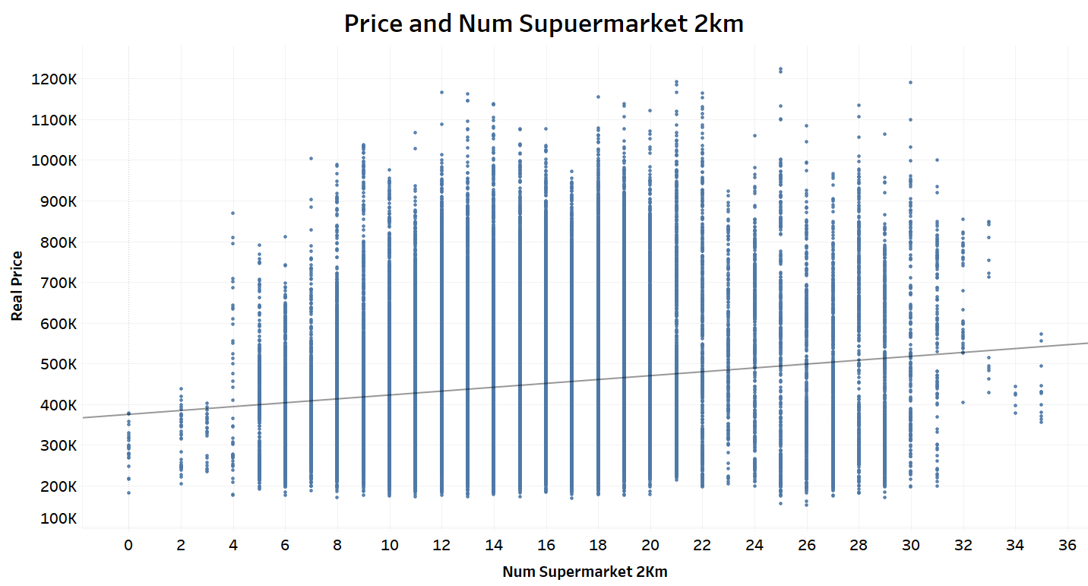
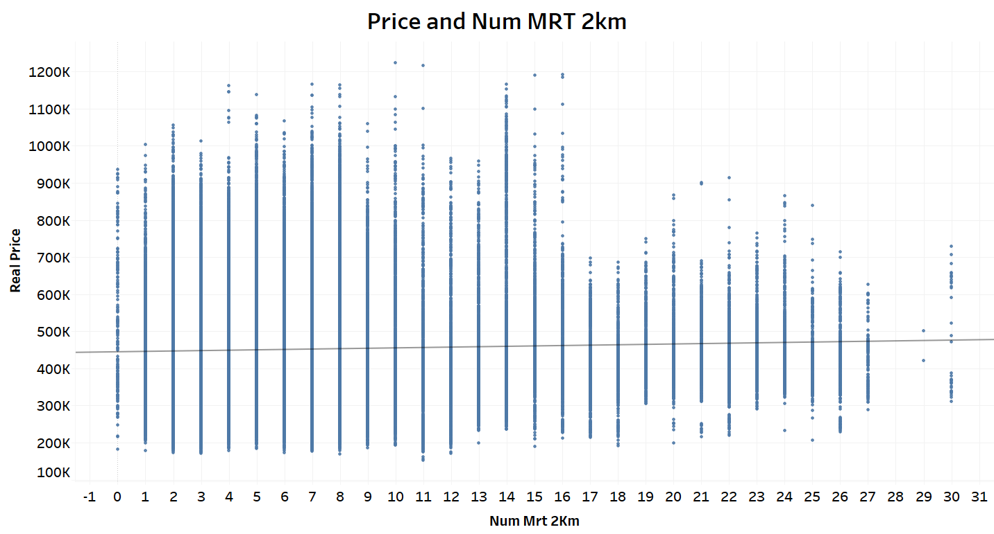
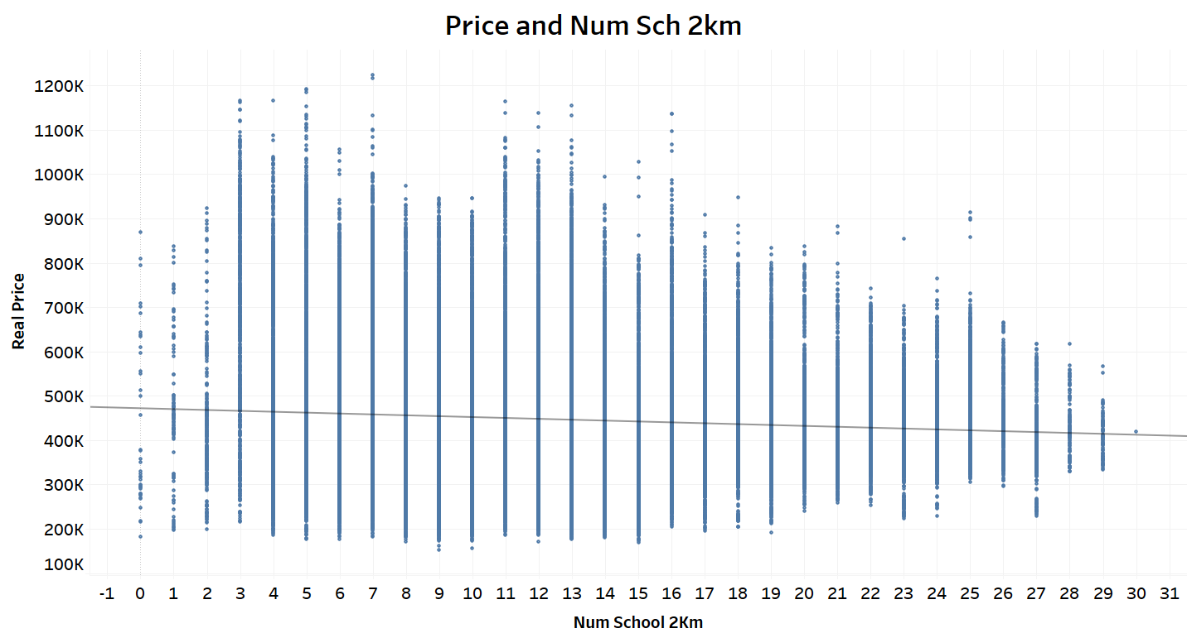
Feature Engineering
Number of amenities within 2km radii
Notes:
There seems to be a slight positive correlation between Number of Supermarkets and MRTs within 2km.

Slide 19
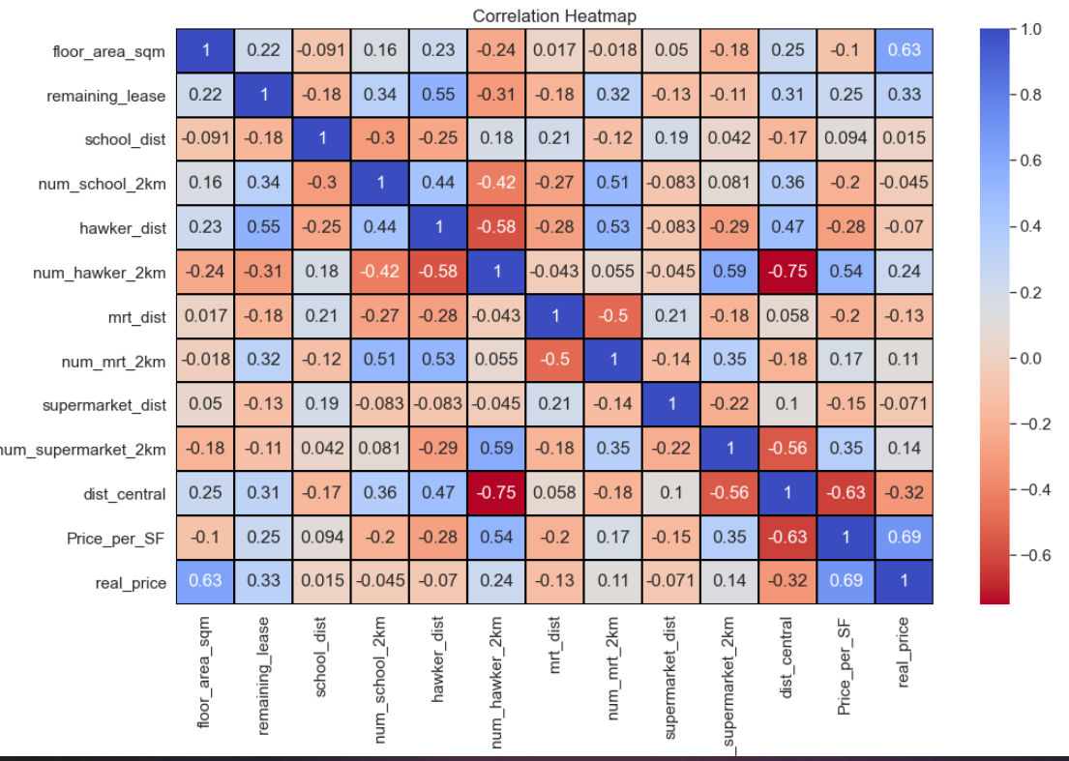
Notes:
Multicollinearity:
Multicollinearity occurs when multiple continous features in a regression model are correlated or dependent on each other to some extent. Change in the value of one feature will also force change the value of features collinear to it.
It becomes difficult for the model to estimate the relationship between each independent variable and the dependent variable independently because the independent variables tend to change in unison.
To measure Multicollinearity, the 2 most common techniques are - Correlation Matrix and Variance Inflation Factor(VIF).
From the correlation heatmap, we can see that num_hawker_2km and dist_central are very correlated.

Slide 20
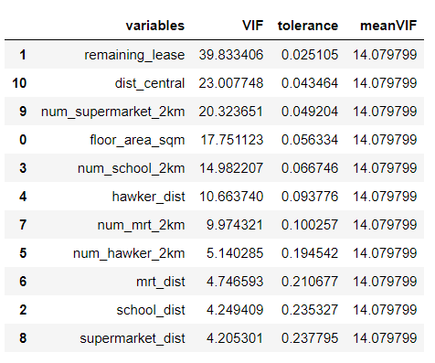
Model preparation
Variation Inflation Factors (VIF)
From the VIF table. We see remaining lease is highest, followed by dist_central, num_supermarket.
All are valuable source of information, so we shall try not to drop them.
We will perform feature scaling first and check the VIF later. VIF often drops after performing scaling.
Notes:
We can use VIF (Variation Inflation Factors) to better identify variables with high multi corllinearity.
VIF starts from 1. A value of 1 means that the factor has no correlation to the other factors.
VIF value 1 - 5: moderate correlation, no need to remove.

Slide 21
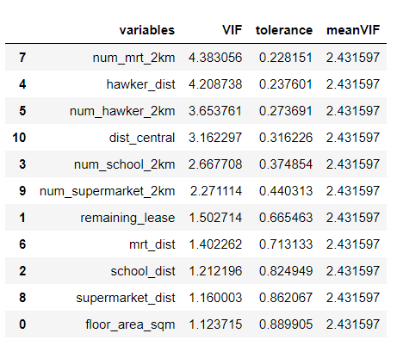
Model preparation
Feature Scaling
New VIF
We perform feature scaling on continuous variables.
This is because the independent variables can have highly varying magnitudes, units and range. But since, most of the machine learning algorithms use Eucledian distance between two data points in their computations, this is a problem
After scaling, VIF is much lower now, no need to drop any features

Slide 22
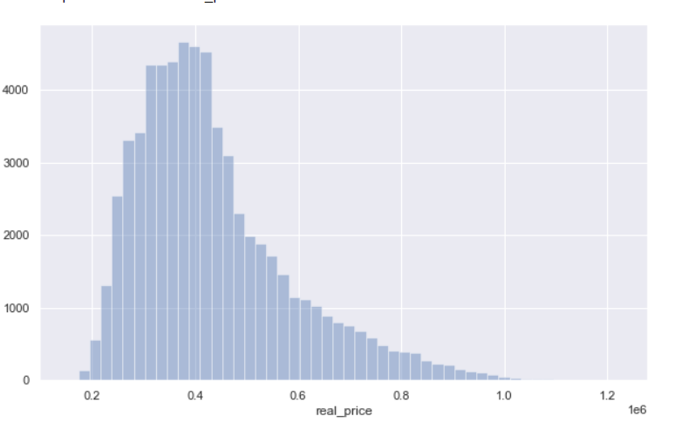
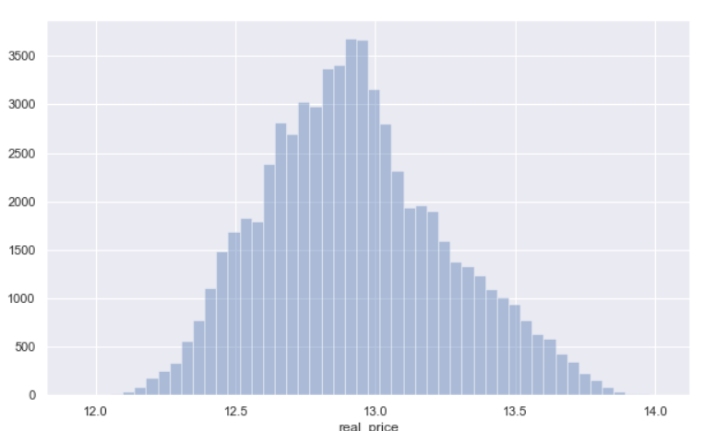
Model preparation
Log Transform Target(real price)
Get Dummies for Categorical Variables
Before
Region: use ‘North’ as baseline
Flat Model: Use ‘model_Standard’ as baseline
Label Encode Ordinal Variables
After
Storey Range
Flat Type

Slide 23
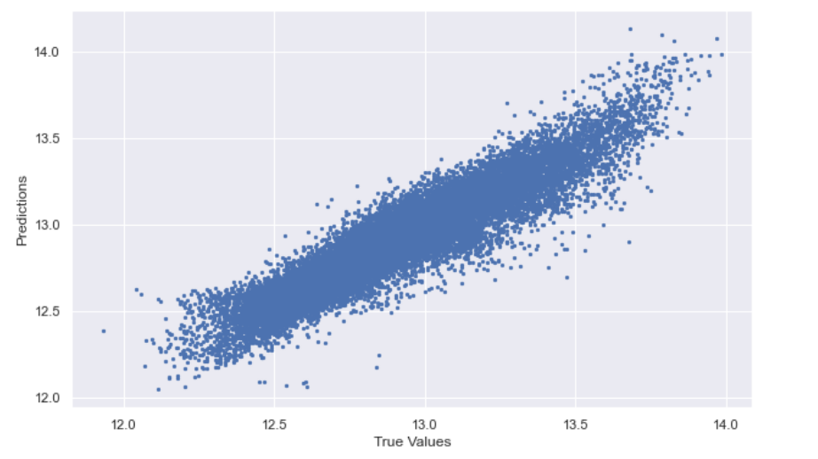
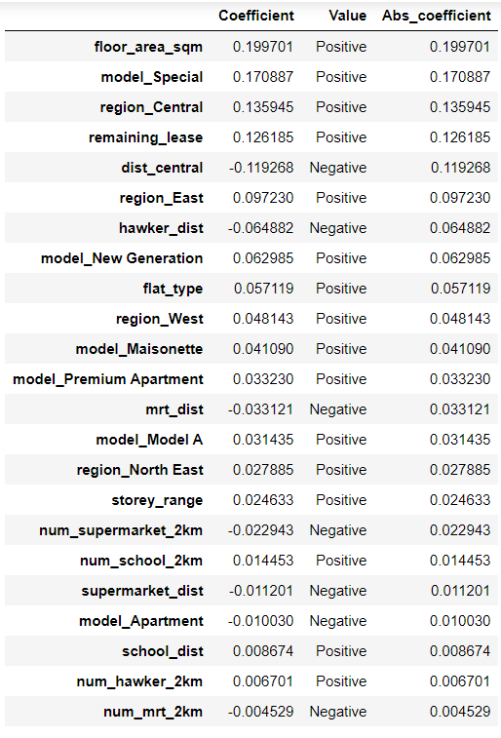
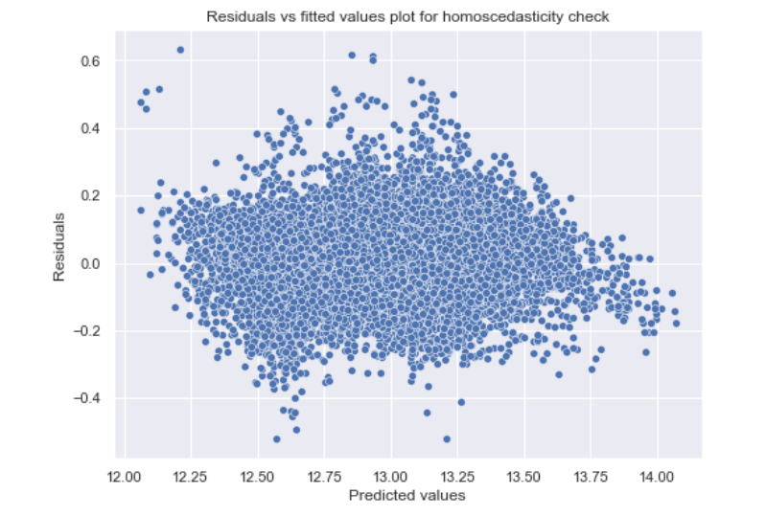
Linear Regression
Predictions vs True Values
Intercept: 12.11518
R-square: 0.877
Coefficients:
Check for Homoscedasticity
Regression plot does seem to show any definite trend
Goldfeld Quandt Test:
'p-value', 0.893 >0.05
Cannot reject the null hypothesis
That error terms are homoscedastic
Notes:
Our Linear model performed quite well, with an R-square of 0.877

Slide 24
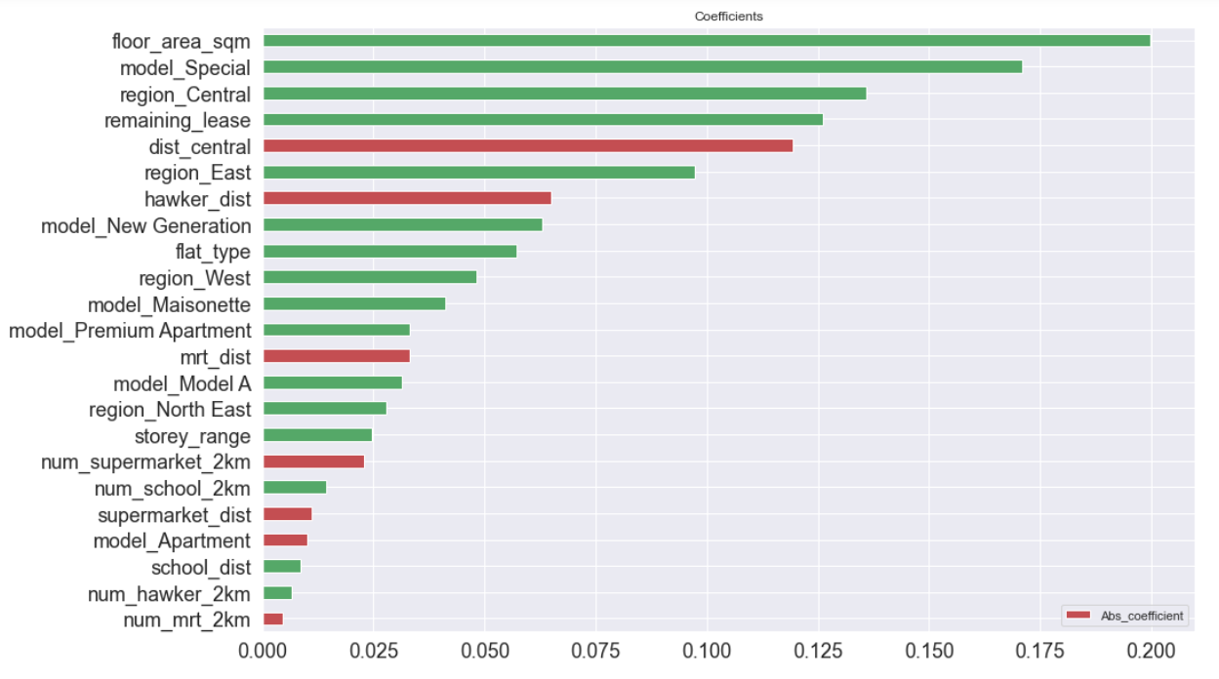
Linear Regression
Coefficient Analysis
Notes:
We can use the value of the coefficients to compare their effects on Housing Price. The larger the absolute value, the greater the effect.
The green color indicates a positive relation, while the red indicates a negative correlation.

Slide 25
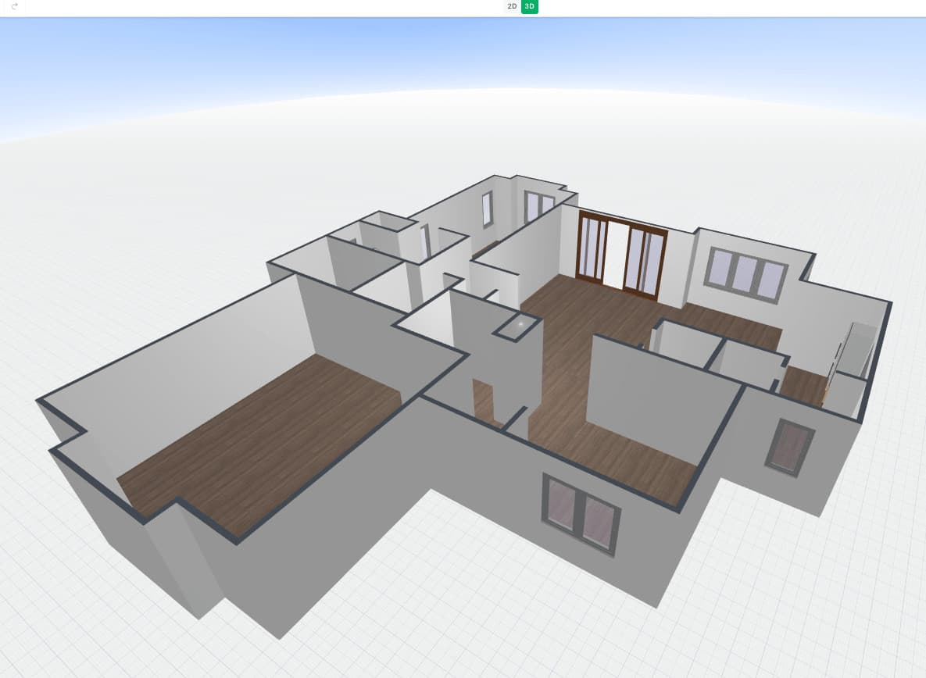

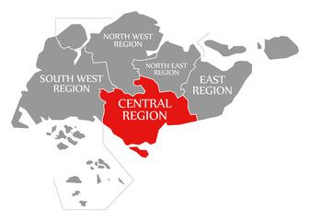
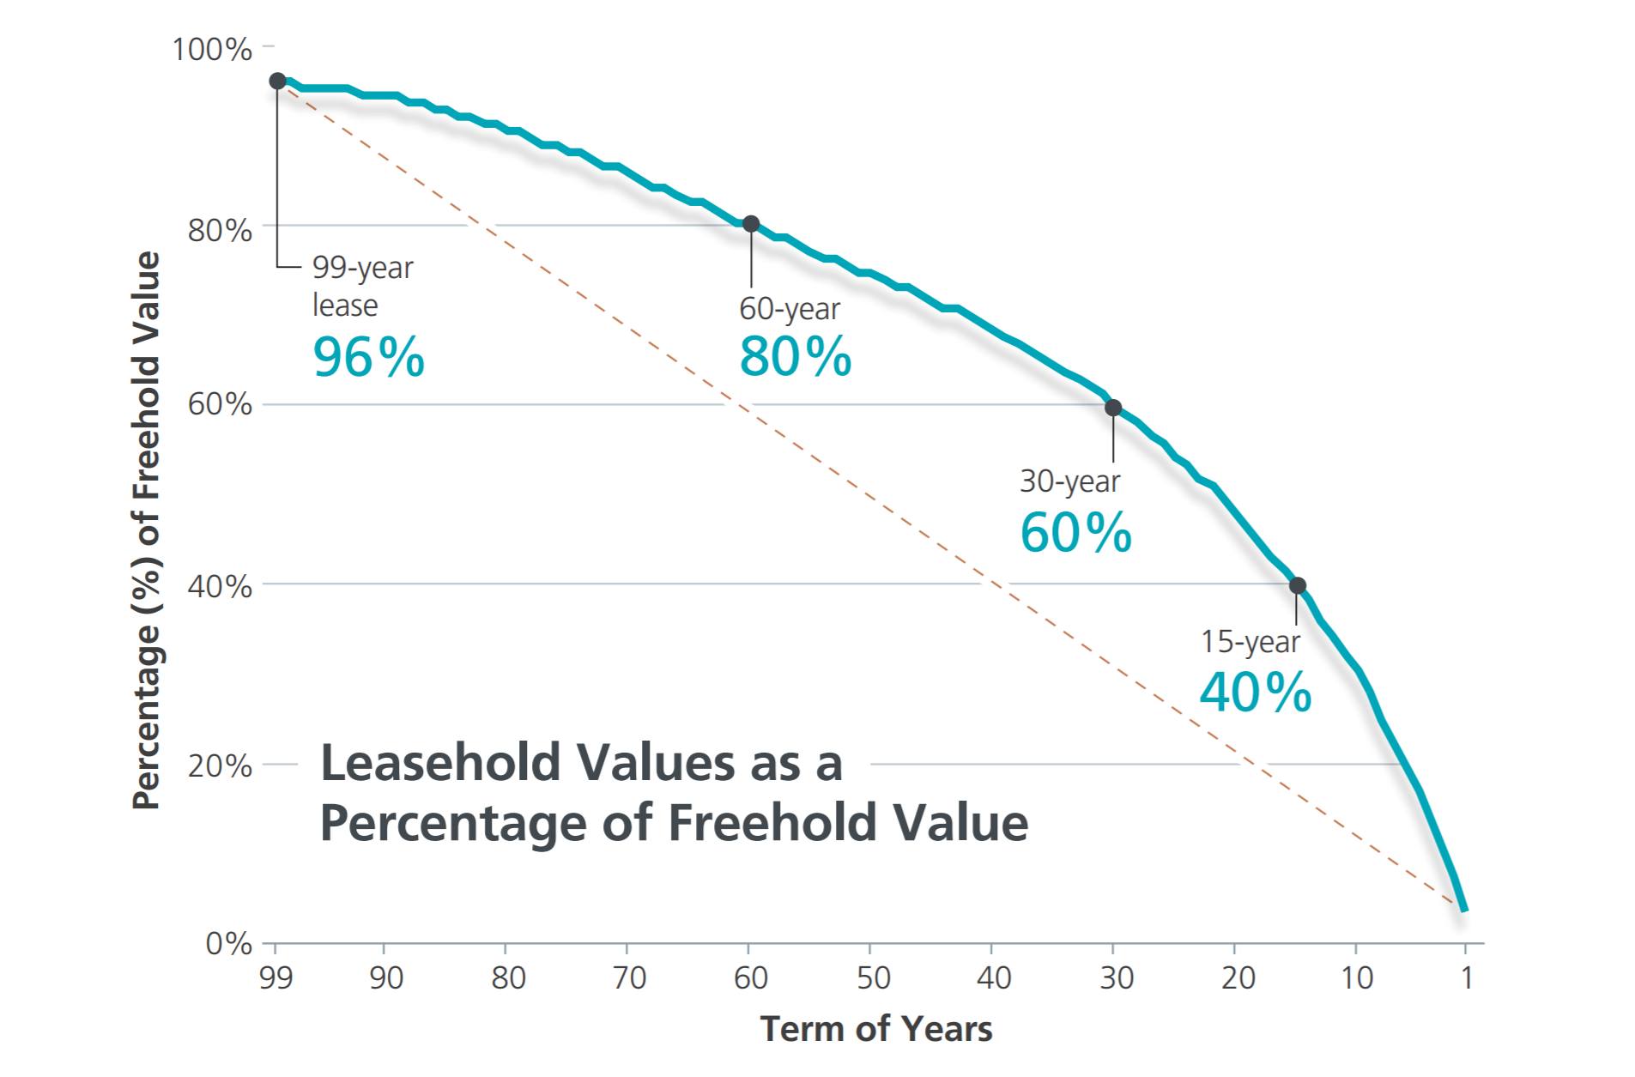
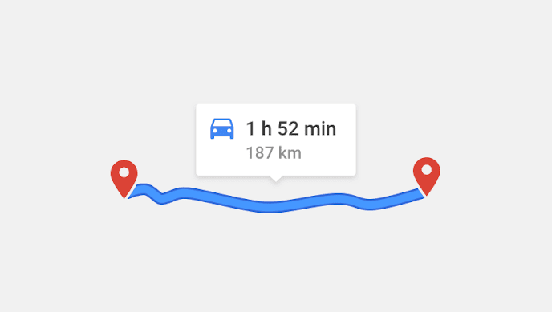
LINEAR Regression: Coefficients
Strong Drivers:
1st Place:
Floor Area Square Meter
Value: 0.188
2nd Place
‘Special’ Flat Model
Value: 0.170
3rd Place
Located in Central Region
Value: 0.136
4th Place
Remaining Lease
Value: 0.126
5th Place
Distance to Central (Raffles Place MRT)
Value: 0.119
Notes:
The top feature is floor area sq meter. Singapore is land-scarce and third most densely populated city worldwide. Demand for land area is very high, so every additional floor sqm results in a large increase in final price.
Coming in second is the flat model - 'Special' category. This category consist of naturally expensive, award winning design houses like DBSS, S1S2 as well as larger houses like adjoined and Terrace. ‘Standard’ model was used as a baseline. Thus, the choice of flat model heavily influences house prices.
In the third place is the Central Region factor. North Region was used as a baseline for comparison. This implies that houses in the central area are significantly more expensive than their North, counterparts. Central > East > West > North East. This shows people value staying in the central for the proximity to CBDs, orchard malls and other amenities.
Following that in 4th place, we have remaining lease years. This shows people place great value on the total number of years left in a potential house.
In the 5th place, we have distance to Central(Raffles Place MRT). The lesser the distance, the higher the price. However, it is likely there is some overlap between this factor’s effect on price, as well as ‘located in Central Area’ factor. Houses built in Central Area would consequently have short distances to Raffles Place MRT station.

Slide 26
LINEAR Regression: Coefficients
Moderate Drivers:
Weak Drivers:
East Region
Distance to nearest hawker
Model: New Generation
Flat Type (number of rooms)
West Region
Model: Maisonette
Model: Premium Apartment
Distance to nearest MRT
Model: Model A
Number of MRTs within 2km
Number of Hawkers within 2km
Distance to nearest school
Model Type: Apartment
Distance to nearest Supermarket
Number of schools within 2km
Number of supermarkets within 2km
Notes:
Distance to the other amenities like Supermarkets, Schools, MRT and Hawker Centers do not seem to be strong drivers of HDB prices. Out of these amenities, hawker distance is the strongest coefficient, followed by MRT distance. The schools and supermarkets are weaker drivers of price.
A possible reason why the distance to amenities variables are not such a strong driver of price is that the expensive houses are usually purchased by those who can afford a car as well. Thus the greater distance is not an inconvenience for these buyers, who are still willing to pay premium prices for the houses. Perhaps if we filter out the more premium priced flats and look only at middle –tier flats, these distance variables might become more relevant.

Slide 27
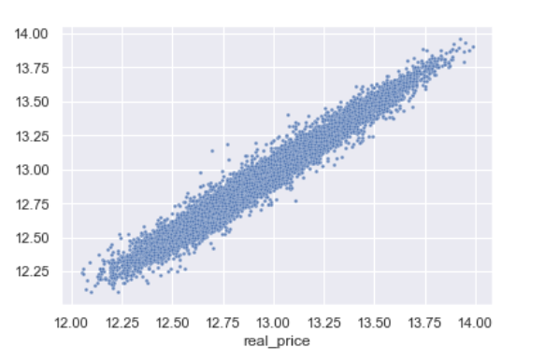
Random forest
Next, we fit Random Forest Regressor with Out-Of-Bag Score
Results:
OOB R2 Score: 0.965
Test Data R2 Score: 0.966
Test Data Mean Absolute Error: 0.045

Slide 28
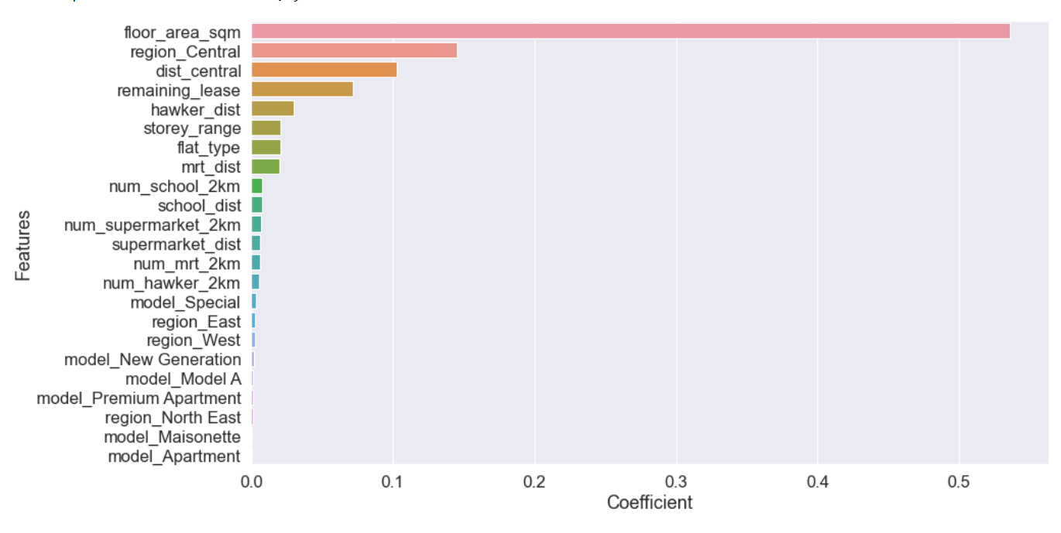
Random forest
Feature Importances
Notes:
The feature coefficients are somewhat similar to that of the linear regression model. Floor area, central region, distance to central and remaining lease are still strong drivers of HDB price.
However, the categorical values like model type, seem to be given less importance. This is likely due to difference in the way tree-based models computes the importance, like how often a particular feature was selected for splitting.

Slide 29
Conclusion
Consistently strong drivers of house prices are:
1. Floor Area
2. Region (Central Area)
3. Flat Model (DBSS, SIS2)
4. Remaining Lease Years
5. Distance to Central
Distance to other amenities, like supermarkets and mrt, do not seem to be strong predictors of price
Limitations:
Linear Model assumes a linear relationship. However, in reality, rarely ever completely linear
Future Directions:
Compute travelling time with the use of public transport, instead of using distance
Filter out expensive houses, and see if distance to amenities coefficients increase in importance
Use Price per Square Feet instead of real_price

